Slide 1
ME759 High Performance Computing for Applications in Engineering [Spring 2020]
Lecture 14
02/24/2019
Dan Negrut, 2020 ME759 UW-Madison

Slide 2
Quote of the day
“You see things; you say, 'Why?' But I dream things that never were; and I say 'Why not?”
-- George Bernard Shaw, Irish playright, 1925 Nobel prize winner in Literature, [1856 - 1950]

Slide 3
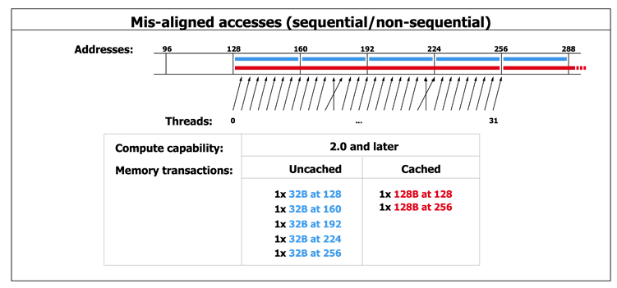
Before we get going…
Last time:
Memory aspects: speed issues
Atomic operations
Today:
Rules of thumb, GPU computing optimization
Test case: reduction operation
Other tidbits:
Assignment due on Thursday at 9 pm
Please read assigned readings
Dan also has office hours online in Canvas each Wd at 7 PM
Next time:
Quick discussion about Final Project proposal

Slide 4
ME759 Final Project
Final Project Proposal due on March 27 (9 PM, in Canvas)
You’ll receive feedback by April 3
There will be a template made available
Two pages long proposal
Template available in two weeks
Final Project due at the time when the Final Exam starts
Exact date TBA

Slide 5
Final Project
Final Project - accounts for 25% of final grade
Your work on Final Project to start no later than April 4:
It is an individual project or outcome of a 2- or 3-student team
You choose a problem that suites your research or interests
I encourage you to tackle a meaningful problem
Attempt to solve a useful problem rather than a problem that you are confident that you can solve
Projects that are not successful are ok, provided you aim high enough and demonstrate good progress
“demonstrate good progress”: we’ll look at your git history to understand level of effort and progress towards goal

Slide 6
Final Project: Default Option
Default Final Project: work on a computational dynamics code that runs in parallel
Profile existing code
Improve performance of the implementation via parallel computing
There might be other project[s] to chose from

Slide 7
CUDA Optimization Rules of Thumb

Slide 8
Writing CUDA Software: High-Priority Recommendations
To get the maximum benefit from CUDA, focus first on finding ways to parallelize sequential code. Expose fine grain parallelism
Minimize data transfer between the host and the device, even if it means running some kernels on the device that do not show performance gains when compared with running them on the host CPU
Very good resource: http://docs.nvidia.com/cuda/cuda-c-best-practices-guide/index.html#abstract

Slide 9
Writing CUDA Software: High-Priority Recommendations
Strive to have aligned and coalesced global memory accesses. Design your implementation such that global memory accesses are coalesced for that part of the red-hot parts of the code
Minimize the use of global memory. Prefer shared memory access where possible (consider tiling as a design solution)
http://docs.nvidia.com/cuda/cuda-c-best-practices-guide/index.html#abstract

Slide 10
Writing CUDA Software: Medium-Priority Recommendations
Accesses to shared memory should be designed to avoid serializing requests due to bank conflicts
Maintain sufficient numbers of active threads per multiprocessor (i.e., sufficient occupancy)
Keep the number of threads per block a multiple of 32 to avoid wasted lanes
http://docs.nvidia.com/cuda/cuda-c-best-practices-guide/index.html#abstract

Slide 11
Writing CUDA Software: Medium-Priority Recommendations
Use the fast math library whenever speed is very important and you can live with a tiny loss of accuracy
Avoid thread divergence
http://docs.nvidia.com/cuda/cuda-c-best-practices-guide/index.html#abstract
Notes:
There used to be a sixth bullet above: 6. Use signed integers rather than unsigned integers as loop counters
The compiler can optimize more aggressively with signed arithmetic than it can with unsigned arithmetic (due to rules regarding overflow behavior). This is of particular note with loop counters
In the C language standard, unsigned integer overflow semantics are well defined, whereas signed integer overflow causes undefined results. Therefore, the compiler can optimize more aggressively with signed arithmetic than it can with unsigned arithmetic. This is of particular note with loop counters: since it is common for loop counters to have values that are always positive, it may be tempting to declare the counters as unsigned. For slightly better performance, however, they should instead be declared as signed.

Slide 12
Some nuts and bolts, compiler related and such

Slide 13
Compiling CUDA Code [with nvcc driver]
C/C++ CUDA
Application
NVCC
CPU Code
PTX Code
PTX to Target
Compile
K20X
…
P100
Target binary cubin code
Notes:
nvcc separates what should run on CPU from GPU code
First stage is to translate into PTX code (assembly)
PTX is machine independent
FORTRAN generates PTX too
Second stage: compile PTX for target GPU

Slide 14
PTX: Parallel Thread eXecution
PTX: an assembly language used in CUDA programming environment
nvcc translates code written in CUDA’s C into the language-agnostic Intermediate Representation, and then into PTX assembly
nvcc subsequently invokes an assembler which translates the PTX into a binary code which can be run on a certain GPU
PTX for fillKernel
.entry _Z10fillKernelPii (
.param .u64 __cudaparm__Z10fillKernelPii_a,
.param .s32 __cudaparm__Z10fillKernelPii_n)
{
.reg .u16 %rh<4>;
.reg .u32 %r<6>;
.reg .u64 %rd<6>;
.reg .pred %p<3>;
.loc 14 5 0
$LDWbegin__Z10fillKernelPii:
mov.u16 %rh1, %ctaid.x;
mov.u16 %rh2, %ntid.x;
mul.wide.u16 %r1, %rh1, %rh2;
cvt.u32.u16 %r2, %tid.x;
add.u32 %r3, %r2, %r1;
ld.param.s32 %r4, [__cudaparm__Z10fillKernelPii_n];
setp.le.s32 %p1, %r4, %r3;
@%p1 bra $Lt_0_1026;
.loc 14 9 0
ld.param.u64 %rd1, [__cudaparm__Z10fillKernelPii_a];
cvt.s64.s32 %rd2, %r3;
mul.wide.s32 %rd3, %r3, 4;
add.u64 %rd4, %rd1, %rd3;
st.global.s32 [%rd4+0], %r3;
$Lt_0_1026:
.loc 14 11 0
exit;
$LDWend__Z10fillKernelPii:
}
__global__ void fillKernel(int *a, int n)
{
int tid = blockIdx.x*blockDim.x + threadIdx.x;
if (tid < n) {
a[tid] = tid;
}
}
Notes:
PTX
similar to assembly code
does not contain information on what particular GPU card the code should run (device neutral representation)
important to distribute CUDA code to clients without knowing their GPU capability
[Colin] PTX is an assembly language. There is a separate assembler called ptxas which is used to build it.
nvcc is an LLVM-based compiler (like Clang); It generates a subset of LLVM IR called NVVM IR, which is then compiled to PTX assembly.
Other CUDA compilers (Fortran, for example) generate this IR, and then the rest of the process acts as normal.

Slide 15
More on the nvcc compiler
File suffix | How the nvcc compiler interprets the file
.cu | CUDA source file, containing host and device code
.cuh | CUDA header files, containing host and device code
.cup | Preprocessed CUDA source file, containing host code and device functions
.c | C source file
.cc, .cxx, .cpp | C++ source file
.gpu | GPU intermediate file (device code only)
.ptx | PTX intermediate assembly file (device code only)
.cubin | CUDA device only binary file
Notes:
nvcc can output
C code (which must then be compiled with the rest using another tool)
ptx code (device independent)
object code (cubin)

Slide 16
The JIT story
C code gets converted into an Intermediate Representation (IR) called NVVM IR
NVVM IR is then converted to PTX assembly
PTX assembly gets assembled into binary code for some number of GPU targets (“cubin”)
Why the intermediate steps?
Brings into the picture the concept of just-in-time (JIT) compiling
Compilers for other languages can generate this intermediate representation rather than implementing a dialect of PTX assembly for each frontend language (Clang and CUDA Fortran do this)
PTX material can be converted at run-time into cubin instructions
Why bother with JIT?
CON: JIT increases the load-time of an application (since an additional compile step needs to happen)
PRO: Allows the app to benefit from newer devices (better compilers, more advanced features supported by the hardware)
The only way an app can run on a device that didn’t exist at the time the PTX was generated
Notes:
[Colin] PTX is an assembly language. There is a separate assembler called ptxas which is used to build it.
nvcc is an LLVM-based compiler (like Clang); It generates a subset of LLVM IR called NVVM IR, which is then compiled to PTX assembly.
Other CUDA compilers (Fortran, for example) generate this IR, and then the rest of the process acts as normal.

Slide 17
JIT and the magic of –code and –arch nvcc flags
How does one control how PTX is generated?
How does one control how the cubin is generated?

Slide 18
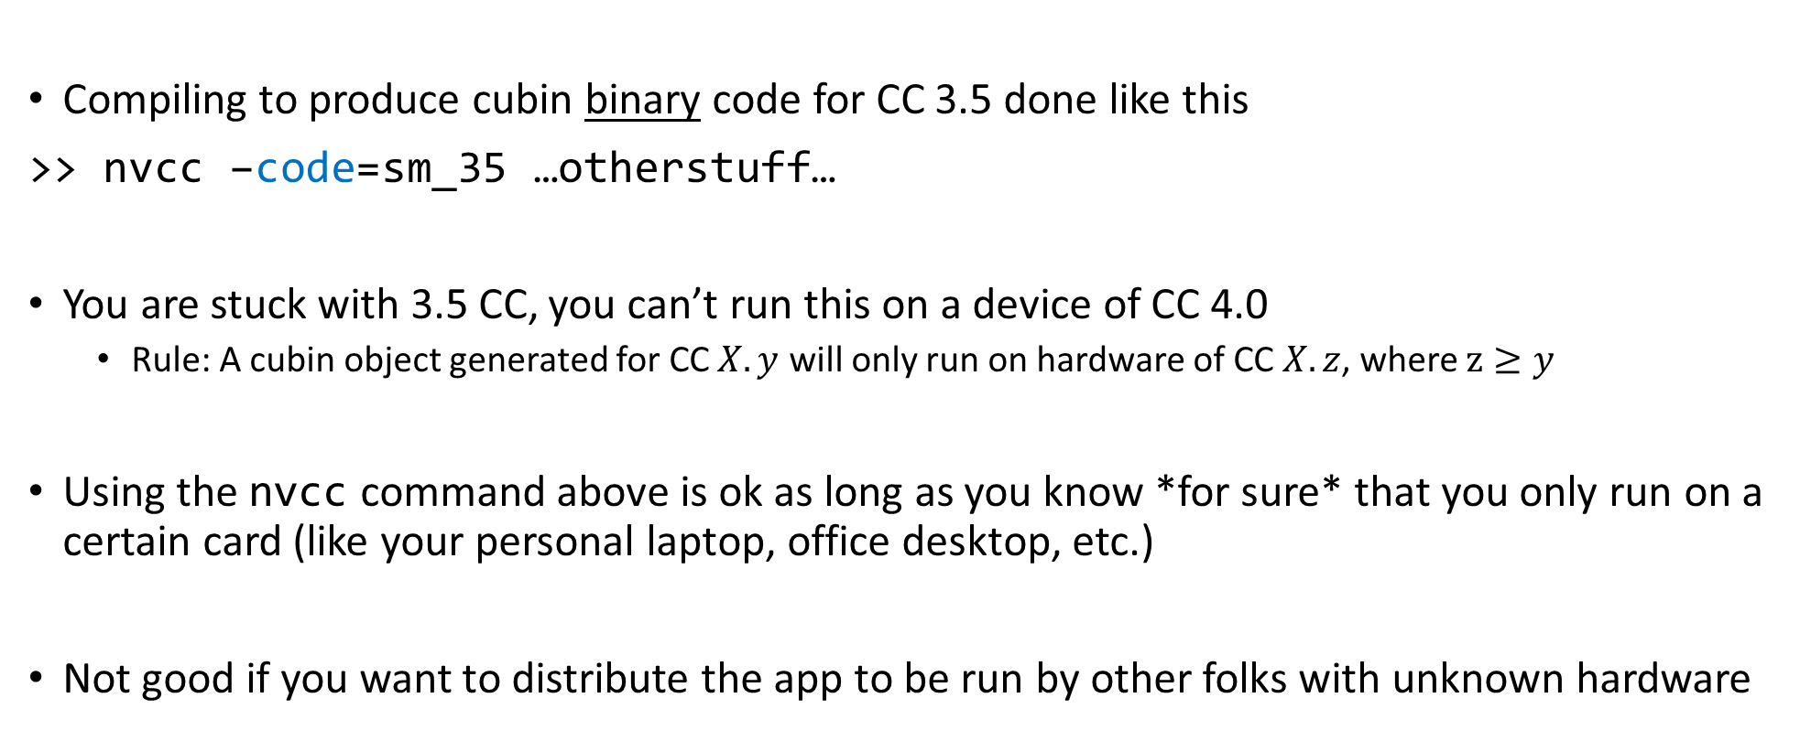
Getting stuck with a CC, via the –code flag
Compiling to produce cubin binary code for CC 3.5 done like this
>> nvcc –code=sm_35 …otherstuff…
You are stuck with 3.5 CC, you can’t run this on a device of CC 4.0
Rule: A cubin object generated for CC $X.y$ will only run on hardware of CC $X.z$, where $z≥y$
Using the nvcc command above is ok as long as you know *for sure* that you only run on a certain card (like your personal laptop, office desktop, etc.)
Not good if you want to distribute the app to be run by other folks with unknown hardware

Slide 19
A word on PTX compatibility, and the role of the –arch flag
Some CUDA features supported only on devices of higher CC
Example: unified (managed) memory
You can control the C to PTX translation so that you do/don’t pick certain CUDA features
Example: Warp Shuffle Function available only in CC 3.0 and above
Code that contains Warp Shuffle functionality should be compiled with this in mind
Accomplished by the use of the –arch=compute_30 flag on nvcc
>> nvcc –arch=compute_30 …blahblah…
NOTE: the PTX generated by the above can then be compiled to cubin to run on higher CC
Recall the cubin generation control by the –code flag

Slide 20
Example, combining –arch and –code via -gencode
>> nvcc x.cu
-gencode arch=compute_35,code=sm_35
-gencode arch=compute_50,code=sm_50
-gencode arch=compute_60,code=\'compute_60,sm_60\'
The cubin fat binary generated by this command embeds the following (it’s got bigger footprint to accommodate all):
Binary code generated to work on Kepler (CC 3.5)
Binary code generated to work on Maxwell (CC 5.0)
PTX and binary code to work on Pascal (CC 6.0)
The arch part says that the binary code in each case should be produced based on PTX code generated as you’d expect: binary for 3.5 comes from PTX for 3.5, binary for 5.0 comes from PTX for 5.0, binary for 6.0 comes from PTX for 6.0
Shortcut: you can get -gencode arch=compute_60,code=\'compute_60,sm_60\‘ by simply saying :
>> nvcc x.cu -arch=sm_60
If you don’t say anything but “nvcc x.cu” the compile driver will use default arch & code settings

Slide 21
CUDA Case Study: Parallel Reduction

Slide 22
Parallel Reduction in CUDA
Exercise draws on material made available by Mark Harris of NVIDIA
Parallel Reduction: Common and important data parallel primitive
Example: Used to compute the norm of a large vector
Easy to implement in CUDA
Challenging to get it to run fast though
Serves as a good optimization example
Walk step by step through several different versions
Demonstrates several important optimization strategies
Results are for old CC, yet it’s instructive to understand how far folks went to get top performance
NVIDIA [M. Harris]→

Slide 23
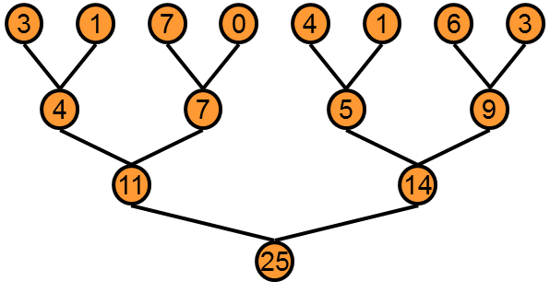
Parallel Reduction
Basic Idea: tree-based approach used within each thread block
Backdrop: assume you have very large arrays – 100,000 entries and beyond
Keep all multiprocessors on the GPU busy
Each thread block reduces a portion of the array to one single value
Q: How do we communicate partial results between thread blocks?
NVIDIA [M. Harris]→

Slide 24
Problem: Global Synchronization
If we could synchronize across all thread blocks, could easily reduce very large arrays
Global sync after each block produces its result
Once all blocks reach sync, continue recursively
But CUDA has no global synchronization
Only synchronization of threads that belong to the same block
Solution: decompose into multiple kernels
Kernel launch serves as a global synchronization point
Kernel launch has negligible overhead
NVIDIA [M. Harris]→

Slide 25
Multiple Kernel Calls [An Example, and how it all works out…]
Imagine you launch a 1D grid in which each 1D block has 256 threads
Assume that the number or elements in the array is N=100,000
Note that 100,000= 390*256 + 160, therefore [(N+255)/256]=391 blocks needed
For the first stage, you launch 391 blocks of 256 threads
At the end of this stage you still have to operate on 391 elements
For the second stage, you launch two blocks of 256 threads
At the end of this stage you only have to operate on two elements
For the third and last stage, you launch one block of 32 threads
Almost all threads will be idle in this case…
NOTE: after the first stage, each subsequent stage operates on a number of entries equal to the number of blocks in the previous stage

Slide 26
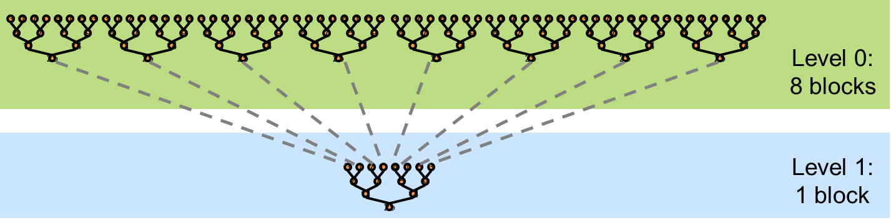
Vector Reduction: 30,000 Feet Perspective
At the block level: Bring data in shared memory, then start adding in parallel
Fewer and fewer threads of a block participate
Recall that there is no synchronization between threads in different blocks
The process is memory bound, low arithmetic intensity…
Data staged in shared memory
A small number of threads finishes off
NVIDIA [M. Harris]→

Slide 27
What is Our Optimization Goal?
We should strive to reach GPU peak performance
Choose the right metric:
GFLOP/s: for compute-bound kernels
Bandwidth: for memory-bound kernels
Reductions have very low arithmetic intensity
1 flop per element loaded (bandwidth-optimal)
Therefore we should strive for peak bandwidth
We’ll go through an old example - results generated using an old G80 GPU
Compute capability (CC) 1.0
384-bit memory interface, 900 MHz DDR
384 * 0.900 *2 / 8 = 86.4 GB/s
Example carries over to other CCs – on NVIDIA hardware this algorithm will always be memory bound
NVIDIA [M. Harris]→

Slide 28
Parallel Reduction: Interleaved Addressing
Values (shared memory)
10 | 1 | 8 | -1 | 0 | -2 | 3 | 5 | -2 | -3 | 2 | 7 | 0 | 11 | 0 | 2
Step 1 Stride 1
Thread IDs
0
2
4
6
8
10
12
14
Values
11 | 1 | 7 | -1 | -2 | -2 | 8 | 5 | -5 | -3 | 9 | 7 | 11 | 11 | 2 | 2
Step 2 Stride 2
Thread IDs
0
4
8
12
Values
18 | 1 | 7 | -1 | 6 | -2 | 8 | 5 | 4 | -3 | 9 | 7 | 13 | 11 | 2 | 2
Step 3 Stride 4
Thread IDs
0
8
Values
24 | 1 | 7 | -1 | 6 | -2 | 8 | 5 | 17 | -3 | 9 | 7 | 13 | 11 | 2 | 2
Step 4 Stride 8
Thread IDs
0
Values
41 | 1 | 7 | -1 | 6 | -2 | 8 | 5 | 17 | -3 | 9 | 7 | 13 | 11 | 2 | 2
Note: in stage s, only threads divisible to 2^s get to do work. Stride: 2^(s-1)
NVIDIA [M. Harris]→
Notes:
In stage s, only thread who’s divisible to 2^s gets to work

Slide 29
Reduction #1: Interleaved Addressing
__global__ void reduce1(int *g_idata, int *g_odata) {
extern __shared__ int sdata[];
// each thread loads one element from global to shared mem
unsigned int tid = threadIdx.x;
unsigned int i = blockIdx.x*blockDim.x + threadIdx.x;
sdata[tid] = g_idata[i];
__syncthreads();
// do reduction in shared mem
for(unsigned int s=1; s < blockDim.x; s *= 2) {
if (tid % (2*s) == 0) {
sdata[tid] += sdata[tid + s];
}
__syncthreads();
}
// write result for this block to global memory
if (tid == 0) g_odata[blockIdx.x] = sdata[0];
}
Why do we need
to sync threads?
First, threads w/ ID multiple of 2 do work
Next, threads w/ ID multiple of 4 do work
Next, threads w/ ID multiple of 8 do work
And so on…
Problem: highly divergent
warps are inefficient, and %
operator is very slow
NVIDIA [M. Harris]→
Notes:
DN: the number of elements after one stage = number of blocks that were launched to deal with that stage
First, threads multiple of 2 do work
Next, threads multiple of 4 do work
Next, threads multiple of 8 do work
And so on…

Slide 30
Performance for 4 Million element reduction
Time (2²² ints)
Bandwidth
Kernel 1: interleaved addressing with divergent branching | 8.054 ms | 2.083 GB/s
Note: Block Size = 128 threads for all tests
NVIDIA [M. Harris]→

Slide 31
Parallel Reduction: Interleaved Addressing
Values (shared memory)
10 | 1 | 8 | -1 | 0 | -2 | 3 | 5 | -2 | -3 | 2 | 7 | 0 | 11 | 0 | 2
Step 1 Stride 2⁰
Thread IDs
0
1
2
3
4
5
6
7
Values
11 | 1 | 7 | -1 | -2 | -2 | 8 | 5 | -5 | -3 | 9 | 7 | 11 | 11 | 2 | 2
Step 2 Stride 2¹
Thread IDs
0
1
2
3
Values
18 | 1 | 7 | -1 | 6 | -2 | 8 | 5 | 4 | -3 | 9 | 7 | 13 | 11 | 2 | 2
Step 3 Stride 2²
Thread IDs
0
1
Values
24 | 1 | 7 | -1 | 6 | -2 | 8 | 5 | 17 | -3 | 9 | 7 | 13 | 11 | 2 | 2
Step 4 Stride 2³
Thread IDs
0
Values
41 | 1 | 7 | -1 | 6 | -2 | 8 | 5 | 17 | -3 | 9 | 7 | 13 | 11 | 2 | 2
New Problem: Shared Memory Bank Conflicts
NVIDIA [M. Harris]→

Slide 32
Reduction #2: Interleaved Addressing
Just replace divergent branch in inner loop…
for (unsigned int s=1; s < blockDim.x; s *= 2) {
if (tid % (2*s) == 0) {
sdata[tid] += sdata[tid + s];
}
__syncthreads();
}
Previous case: one thread works, several next to it don’t.
This case: thread A works & A+1 works too, except that A+1 goes far from the memory location where thread A goes
…with strided index and non-divergent branch:
for (unsigned int s=1; s < blockDim.x; s *= 2) {
int index = 2 * s * tid;
if (index < blockDim.x) {
sdata[index] += sdata[index + s];
}
__syncthreads();
}
NVIDIA [M. Harris]→
Notes:
First case: one thread works, several next to it don’t.
Second case: thread A works and A+1 works too, except that it goes far from the memory location where thread A goes

Slide 33
Performance for 4M element reduction
Step Speedup
Cumulative Speedup
Time (2²² ints)
Bandwidth
Kernel 1: interleaved addressing with divergent branching | 8.054 ms | 2.083 GB/s
Kernel 2: interleaved addressing with bank conflicts | 3.456 ms | 4.854 GB/s | 2.33x | 2.33x
NVIDIA [M. Harris]→

Slide 34
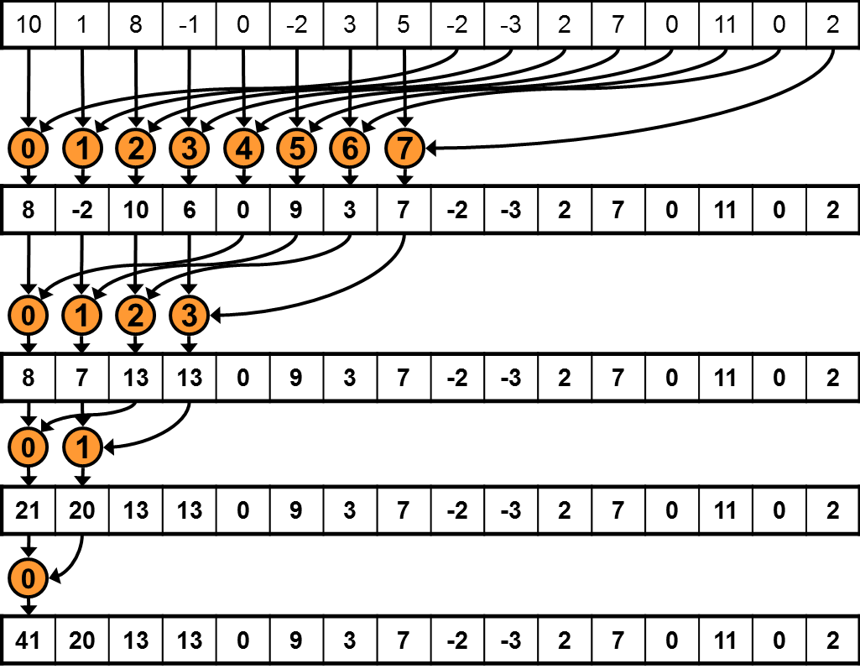
Parallel Reduction: Sequential Addressing
Values (shared memory)
Step 1 Stride 8
Thread IDs
Values
Step 2 Stride 4
Thread IDs
Values
Step 3 Stride 2
Thread IDs
Values
Step 4 Stride 1
Thread IDs
Values
Sequential addressing is Shared Mem. conflict free
NVIDIA [M. Harris]→

Slide 35
Reduction #3: Sequential Addressing
Just replace strided indexing in inner loop…
for (unsigned int s=1; s < blockDim.x; s *= 2) {
int index = 2 * s * tid;
if (index < blockDim.x) {
sdata[index] += sdata[index + s];
}
__syncthreads();
}
…with reversed loop and threadID-based indexing:
for (unsigned int s=blockDim.x/2; s>0; s>>=1) {
if (tid < s) {
sdata[tid] += sdata[tid + s];
}
__syncthreads();
}
First you go out 1/2 the block size to match a thread with its second operand
Then you go out 1/4 of the block size
Then you go out 1/8 of the block size
Etc.
NVIDIA [M. Harris]→
Notes:
DN:
- First you go half the size of the block to match a thread with its second operand
- Then you go ¼ of the block size
- Then you go 1/8 of the block size, etc.

Slide 36
Performance for 4M element reduction
Step Speedup
Cumulative Speedup
Time (2²² ints)
Bandwidth
Kernel 1: interleaved addressing with divergent branching | 8.054 ms | 2.083 GB/s
Kernel 2: interleaved addressing with bank conflicts | 3.456 ms | 4.854 GB/s | 2.33x | 2.33x
Kernel 3: sequential addressing | 1.722 ms | 9.741 GB/s | 2.01x | 4.68x
NVIDIA [M. Harris]→

Slide 37
Idle Threads…
Current solution:
for (unsigned int s=blockDim.x/2; s>0; s>>=1) {
if (tid < s) {
sdata[tid] += sdata[tid + s];
}
__syncthreads();
}
Half of the threads are idle on first loop iteration. This is wasteful…
NVIDIA [M. Harris]→

Slide 38
Reduction #4: First Add During Load
Replace single load:
// each thread loads one element from global to shared mem
unsigned int tid = threadIdx.x;
unsigned int i = blockIdx.x*blockDim.x + threadIdx.x;
sdata[tid] = g_idata[i];
__syncthreads();
…With two loads and first add of the reduction:
// perform first level of reduction upon reading from
// global memory and writing to shared memory
unsigned int tid = threadIdx.x;
unsigned int i = blockIdx.x*(blockDim.x*2) + threadIdx.x;
sdata[tid] = g_idata[i] + g_idata[i+blockDim.x];
__syncthreads();
Side-effect: number of blocks needed half of what it used to be…
NVIDIA [M. Harris]→
Notes:
DN: Instead of fetching one number, each thread now fetches two numbers. Therefore, the number of blocks is ½ of what used to be.
DN: A thread T brings from some position and also what used to be one block away. That’s why you have the “blockDim.x*2” in the computation of i

Slide 39
Performance for 4M element reduction
Step Speedup
Cumulative Speedup
Time (2²² ints)
Bandwidth
Kernel 1: interleaved addressing with divergent branching | 8.054 ms | 2.083 GB/s
Kernel 2: interleaved addressing with bank conflicts | 3.456 ms | 4.854 GB/s | 2.33x | 2.33x
Kernel 3: sequential addressing | 1.722 ms | 9.741 GB/s | 2.01x | 4.68x
Kernel 4: first add during global load | 0.965 ms | 17.377 GB/s | 1.78x | 8.34x
NVIDIA [M. Harris]→

Slide 40
Instruction Bottleneck
At 17 GB/s, we’re far from bandwidth bound
Therefore a likely bottleneck is instruction overhead
Ancillary instructions that are not loads, stores, or core arithmetic
In other words: address arithmetic and loop overhead
Strategy: unroll loops
NVIDIA [M. Harris]→

Slide 41
Unrolling the Last Warp
As reduction proceeds, the number of “active” threads decreases
When s <= 32, we have only one warp left
Instructions executed in lockstep fashion within a warp (not on Volta, though!)
That means when s <= 32:
We don’t need to __syncthreads()
We don’t need “if (tid < s)” because it doesn’t save any work
The key idea: unroll the last 6 iterations of the inner loop, which involve 32 or less threads
NVIDIA [M. Harris]→

Slide 42

“unroll the last 6 iterations of the inner loop, which involve 32 or less threads”
- Entry we care about, when last thread works on data
Legend:
- Entry that is read in order to update a “blue” entry
[https://www.amazon.com/ZXUY-Measurement-Also-Centimetre-Reverse/dp/B008U4E7RU]$→$

Slide 43
Reduction #5: Unroll the Last Warp
// and use later like this…
for (unsigned int s=blockDim.x/2; s>32; s>>=1) {
if (tid < s)
sdata[tid] += sdata[tid + s];
__syncthreads();
}
if (tid < 32) warpReduce(sdata, tid);
This used to be:
S>0
__device__ void warpReduce(volatile int* sdata, int tid) {
sdata[tid] += sdata[tid + 32];
sdata[tid] += sdata[tid + 16];
sdata[tid] += sdata[tid + 8];
sdata[tid] += sdata[tid + 4];
sdata[tid] += sdata[tid + 2];
sdata[tid] += sdata[tid + 1];
}
IMPORTANT: For this to be correct, we must use the “volatile” keyword!
Note: This saves useless work in all warps, not just the last one!
Without unrolling, all warps execute every iteration of the for loop and if statement
NVIDIA [M. Harris]→

Slide 44
Performance for 4M element reduction
Step Speedup
Cumulative Speedup
Time (2²² ints)
Bandwidth
Kernel 1: interleaved addressing with divergent branching | 8.054 ms | 2.083 GB/s
Kernel 2: interleaved addressing with bank conflicts | 3.456 ms | 4.854 GB/s | 2.33x | 2.33x
Kernel 3: sequential addressing | 1.722 ms | 9.741 GB/s | 2.01x | 4.68x
Kernel 4: first add during global load | 0.965 ms | 17.377 GB/s | 1.78x | 8.34x
Kernel 5: unroll last warp | 0.536 ms | 31.289 GB/s | 1.8x | 15.01x
NVIDIA [M. Harris]→

Slide 45
Complete Unrolling
If we knew the number of iterations (or equivalently, of threads in a block) at compile time, we could completely unroll the reduction
Luckily, the block size on G80 is limited by the GPU to 512 threads
1024 on Fermi GPUs and newer
Also, we are sticking to power-of-2 block sizes
Basic idea: unroll everything for a fixed block size
But we need to be generic – how can we unroll for block sizes that we don’t know at compile time?
Use of templates can solve this issue…
CUDA supports C++ template parameters on device and host functions
NVIDIA [M. Harris]→

Slide 46
Unrolling with Templates
Specify block size as a function template parameter
The kernel is parameterized:
template <unsigned int blockSize>
__global__ void reduce6(int *g_idata, int *g_odata)
NVIDIA [M. Harris]→

Slide 47
Reduction #6: Completely Unrolled
This is the key part of the kernel
if (blockSize >= 512) {
if(tid < 256){ sdata[tid] += sdata[tid + 256]; } __syncthreads();}
if (blockSize >= 256) {
if(tid < 128){ sdata[tid] += sdata[tid + 128]; } __syncthreads();}
if (blockSize >= 128) {
if(tid < 64){ sdata[tid] += sdata[tid + 64]; } __syncthreads();}
if (tid < 32) warpReduce<blockSize>(sdata, tid); // last warp only
This is a helper function (device only)
template <unsigned int blockSize>
__device__ void warpReduce(volatile int* sdata, int tid) {
if (blockSize >= 64) sdata[tid] += sdata[tid + 32];
if (blockSize >= 32) sdata[tid] += sdata[tid + 16];
if (blockSize >= 16) sdata[tid] += sdata[tid + 8];
if (blockSize >= 8) sdata[tid] += sdata[tid + 4];
if (blockSize >= 4) sdata[tid] += sdata[tid + 2];
if (blockSize >= 2) sdata[tid] += sdata[tid + 1];
}
All code in RED will be evaluated at compile time. Results in a very efficient inner loop.
For Fermi and newer CC, you’d have one more if statement that covers the case when blockSize>=1024
You can call the warpReduce function only when you got to one warp. Reason: you don’t have to synchronize at that point.
NVIDIA [M. Harris]→
Notes:
You can call the warpReduce function only when you got to one wrap. Reason: you don’t have to synchronize at that point.

Slide 48
Invoking Template Kernels
Don’t we still need block size at compile time?
There is a way out, use a switch statement for 10 possible block sizes:
This is code on the host, calling the appropriate kernel
switch (threads) {
case 512:
reduce6<512><<< dimGrid, dimBlock, smemSize >>>(d_idata, d_odata); break;
case 256:
reduce6<256><<< dimGrid, dimBlock, smemSize >>>(d_idata, d_odata); break;
case 128:
reduce6<128><<< dimGrid, dimBlock, smemSize >>>(d_idata, d_odata); break;
case 64:
reduce6< 64><<< dimGrid, dimBlock, smemSize >>>(d_idata, d_odata); break;
case 32:
reduce6< 32><<< dimGrid, dimBlock, smemSize >>>(d_idata, d_odata); break;
case 16:
reduce6< 16><<< dimGrid, dimBlock, smemSize >>>(d_idata, d_odata); break;
case 8:
reduce6< 8><<< dimGrid, dimBlock, smemSize >>>(d_idata, d_odata); break;
case 4:
reduce6< 4><<< dimGrid, dimBlock, smemSize >>>(d_idata, d_odata); break;
case 2:
reduce6< 2><<< dimGrid, dimBlock, smemSize >>>(d_idata, d_odata); break;
case 1:
reduce6< 1><<< dimGrid, dimBlock, smemSize >>>(d_idata, d_odata); break;
}
NVIDIA [M. Harris]→
Notes:
DN: You don’t know at compile time the value of “threads” in the “switch” statement but you are covered since for each “case” the compiler generates optimal code since you provided the template argument.

Slide 49
Performance for 4 Million element reduction
Step Speedup
Cumulative Speedup
Time (2²² ints)
Bandwidth
Kernel 1: interleaved addressing with divergent branching | 8.054 ms | 2.083 GB/s
Kernel 2: interleaved addressing with bank conflicts | 3.456 ms | 4.854 GB/s | 2.33x | 2.33x
Kernel 3: sequential addressing | 1.722 ms | 9.741 GB/s | 2.01x | 4.68x
Kernel 4: first add during global load | 0.965 ms | 17.377 GB/s | 1.78x | 8.34x
Kernel 5: unroll last warp | 0.536 ms | 31.289 GB/s | 1.8x | 15.01x
Kernel 6: completely unrolled | 0.381 ms | 43.996 GB/s | 1.41x | 21.16x
NVIDIA [M. Harris]→

Slide 50
Parallel Reduction Complexity
Assume that the number of elements in array is of the form N=2^{D}
Log N parallel stages, each stage S requires N/2^{S} independent ops
Stage Complexity is O(log N)
For N=2^{D}, approach requires a total of ∑_{S∈[1..D]}2^{D-S} = N-1 operations
Work Complexity is O(N) – It is work-efficient
That is, it does not perform more operations than a sequential algorithm
Time complexity, for P threads physically in parallel (P processors): O(N/P + log N)
Compare to O(N) for sequential reduction
In a thread block, N=P, so O(log N)
NVIDIA [M. Harris]→

Slide 51
What About Cost?
Cost of a parallel algorithm is processors × time complexity
Allocate threads instead of processors: O(N) threads
Time complexity is O(log N), so cost is O(N log N) : not cost efficient!
Brent’s theorem suggests O(N/log N) threads
Each thread does O(log N) sequential work
Then all O(N/log N) threads cooperate for O(log N) stages
Cost = O((N/log N) * log N) = O(N) → cost efficient
Sometimes called algorithm cascading
Can lead to significant speedups in practice
NVIDIA [M. Harris]→

Slide 52
Algorithm Cascading
Combine sequential and parallel reduction
Each thread loads and sums multiple elements into shared memory
Tree-based reduction in shared memory
Brent’s theorem says each thread should sum O(log N) elements
i.e. 1024 or 2048 elements per block vs. 256
Probably beneficial to push it even further
Possibly better latency hiding with more work per thread
More threads per block reduces levels in tree of recursive kernel invocations
High kernel launch overhead in last levels with few blocks
On G80, best performance with 64-256 blocks of 128 threads
1024-4096 elements per thread
NVIDIA [M. Harris]→

Slide 53
Kernel 7, Comments
For the first six kernels a large number of blocks was used to “tile” the array
Kernel 7: reduce the number of blocks and have a thread do more work than just fetch something to shared memory
Example [cooked up, not related to actual CUDA warp size, typical CUDA block dim, etc.]:
Say you have 1024 elements stored in an array; you need to reduce that array
You start with 32 blocks, each with 4 threads
Then, 128 threads total. It means that a thread, say in block 11, would have to add two numbers, then two numbers, then two numbers, then two more numbers.
At this point, everything is in the union of the shared memory associated with the 32 blocks. At this point proceed like before with kernel 6.

Slide 54
Reduction #7: Multiple Adds / Thread
Replace load and add of two elements:
unsigned int tid = threadIdx.x;
unsigned int i = blockIdx.x*(blockDim.x*2) + threadIdx.x;
sdata[tid] = g_idata[i] + g_idata[i+blockDim.x];
__syncthreads();
With a while loop to add as many as necessary:
unsigned int tid = threadIdx.x;
unsigned int i = blockIdx.x*(blockSize*2) + threadIdx.x;
unsigned int gridSize = blockSize*2*gridDim.x;
sdata[tid] = 0;
while (i < n) {
sdata[tid] += g_idata[i] + g_idata[i+blockSize];
i += gridSize;
}
__syncthreads();
Note: gridSize loop stride to maintain coalescing!
NVIDIA [M. Harris]→

Slide 55
Performance for 4 Million element reduction
Step Speedup
Cumulative Speedup
Time (2²² ints)
Bandwidth
Kernel 1: interleaved addressing with divergent branching | 8.054 ms | 2.083 GB/s
Kernel 2: interleaved addressing with bank conflicts | 3.456 ms | 4.854 GB/s | 2.33x | 2.33x
Kernel 3: sequential addressing | 1.722 ms | 9.741 GB/s | 2.01x | 4.68x
Kernel 4: first add during global load | 0.965 ms | 17.377 GB/s | 1.78x | 8.34x
Kernel 5: unroll last warp | 0.536 ms | 31.289 GB/s | 1.8x | 15.01x
Kernel 6: completely unrolled | 0.381 ms | 43.996 GB/s | 1.41x | 21.16x
Kernel 7: multiple elements per thread | 0.268 ms | 62.671 GB/s | 1.42x | 30.04x
Kernel 7 on 32M elements: 73 GB/s!
NVIDIA [M. Harris]→

Slide 56
Final Kernel…
template <unsigned int blockSize>
__device__ void warpReduce(volatile int *sdata, unsigned int tid) {
if (blockSize >= 64) sdata[tid] += sdata[tid + 32];
if (blockSize >= 32) sdata[tid] += sdata[tid + 16];
if (blockSize >= 16) sdata[tid] += sdata[tid + 8];
if (blockSize >= 8) sdata[tid] += sdata[tid + 4];
if (blockSize >= 4) sdata[tid] += sdata[tid + 2];
if (blockSize >= 2) sdata[tid] += sdata[tid + 1];
}
template <unsigned int blockSize>
__global__ void reduce7(int *g_idata, int *g_odata, unsigned int n) {
extern __shared__ int sdata[];
unsigned int tid = threadIdx.x;
unsigned int i = blockIdx.x*(blockSize*2) + tid;
unsigned int gridSize = blockSize*2*gridDim.x;
sdata[tid] = 0;
while (i < n) { sdata[tid] += g_idata[i] + g_idata[i+blockSize]; i += gridSize; }
__syncthreads();
if (blockSize >= 512) { if (tid < 256) { sdata[tid] += sdata[tid + 256]; } __syncthreads(); }
if (blockSize >= 256) { if (tid < 128) { sdata[tid] += sdata[tid + 128]; } __syncthreads(); }
if (blockSize >= 128) { if (tid < 64) { sdata[tid] += sdata[tid + 64]; } __syncthreads(); }
if (tid < 32) warpReduce(sdata, tid);
if (tid == 0) g_odata[blockIdx.x] = sdata[0];
}
NVIDIA [M. Harris]→
Notes:
DN: you have a relatively small number of blocks. Therefore, one thread does a lot of ops to shrink the total number of entries that need to be added.
Cooked up example, not related to size of warps, typical CUDA block dim, etc.:
Say you have 1024 numbers. You start with 32 blocks, each with 4 threads. Then, 128 threads total. It means that a thread in block 11 would have to add two numbers, then two numbers, then two numbers, then two more numbers. At this point, everything is in shared memory.

Slide 57
Performance Comparison
NVIDIA [M. Harris]→

Slide 58
Sources of Efficiency Improvement
Algorithmic optimizations
Changes to addressing, algorithm cascading
11.84x speedup, combined
Code optimizations
Loop unrolling
2.54x speedup, combined
NVIDIA [M. Harris]→

Slide 59
Lessons Learned, Vector Reduction
Understand CUDA performance characteristics
Memory coalescing
Warp divergence
Bank conflicts
Latency hiding
Use peak performance metrics to guide optimization
Know how to identify type of bottleneck
E.g. memory, core computation, or instruction overhead
Optimize your algorithm, then unroll loops
Use template parameters to generate optimal code
Understand parallel algorithm complexity theory
NVIDIA [M. Harris]→

Slide 60
CUDA Case Study: Parallel Prefix Scan on the GPU

Slide 61
Software Design Exercise: Parallel Prefix Scan
Implementation of prefix sum
Serial implementation – assigned as HW early in the semester
Parallel implementation: topic of next assignment
Goal 1: Getting additional exposure to CUDA programming and thinking that goes behind it
Goal 2: Understand that
Different algorithmic designs lead to different performance levels
Hardware constraints come into play in your applications and/or design solutions
Goal 3: Identify design patterns that can result in superior parallel performance
Understand that there are patterns and it’s worth being aware of them
To a large extend, patterns are shaped up by the underlying hardware
Notes:
DN: Patterns are the tricks of the trade

Slide 62
Parallel Prefix Sum (Scan)
Definition:
The all-prefix-sums operation takes a binary associative operator ⊕ with identity I, and an array of n elements
[a₀, a₁, …, a_{n-1}]
and returns the ordered set
[I, a₀, (a₀ ⊕ a₁), …, (a₀ ⊕ a₁ ⊕ … ⊕ a_{n-2})].
Example: If ⊕ is addition, then scan on the set
[3 1 7 0 4 1 6 3]
returns the set
[0 3 4 11 11 15 16 22]
Exclusive scan: last input element is not included in the result
(From Blelloch, 1990, “Prefix Sums and Their Applications)

Slide 63
Scan on the CPU
void scan( float* scanned, float* input, int length)
{
scanned[0] = 0;
for(int i = 1; i < length; ++i)
{
scanned[i] = scanned[i-1] + input[i-1];
}
}
Just add each element to the sum of the elements before it
Trivial, but sequential
Tempted to say that algorithms don’t come more sequential than this…
Requires exactly n-1 adds
Notes:
(Dan): n-1 instead of n adds

Slide 64
Applications of Scan
Scan is a simple and useful parallel building block
Convert recurrences from sequential … out[0] = f(0)
for(j=1;j<n;j++) out[j] = out[j-1] + f(j);
… into parallel:
forall(j) in parallel
temp[j] = f(j); scan(out, temp);
Useful in implementation of several parallel algorithms:
Radix sort
Quicksort
String comparison
Lexical analysis
Stream compaction
Polynomial evaluation
Solving recurrences
Tree operations
Histograms
Etc.
HK-UIUC

Slide 65
Parallel Scan Algorithm Solution #1: Hillis & Steele (1986)
Implementation of the algorithm shown requires two buffers of length n (shown is the case n=8=2³)
Assumption: the number n of elements is a power of 2: n=2^{M}
NVIDIA [M. Harris]→

Slide 66
The Plain English Perspective
First iteration, I go with stride 1=2⁰
Start at x[2^{M}] and apply this stride to all the array elements before x[2^{M}] to find the mate of each of them. When looking for the mate, the stride should not land you before the beginning of the array. The sum replaces the element of higher index.
This means that I have 2^{M}- 2⁰ additions
Second iteration, I go with stride 2=2¹
Start at x[2^{M}] and apply this stride to all the array elements before x[2^{M}] to find the mate of each of them. When looking for the mate, the stride should not land you before the beginning of the array. The sum replaces the element of higher index.
This means that I have 2^{M} – 2¹ additions
Third iteration: I go with stride 4=2²
Start at x[2^{M}] and apply this stride to all the array elements before x[2^{M}] to find the mate of each of them. When looking for the mate, the stride should not land you before the beginning of the array. The sum replaces the element of higher index.
This means that I have 2^{M} – 2² additions
… (and so on)

Slide 67
The Plain English Perspective
Consider the k^{th} iteration (where 1<k<M-1): I go with stride 2^{k-1}
Start at x[2^{M}] and apply this stride to all the array elements before x[2^{M}] to find the mate of each of them. When looking for the mate, the stride should not land you before the beginning of the array. The sum replaces the element of higher index.
This means that I have 2^{M}-2^{k-1} additions
…
Mth iteration: I go with stride 2^{M-1}
Start at x[2^{M}] and apply this stride to all the array elements before x[2^{M}] to find the mate of each of them. When looking for the mate, the stride should not land you before the beginning of the array. The sum replaces the element of higher index.
This means that I have 2^{M}-2^{M-1} additions
NOTE: There is no (M+1)^{th} iteration since this would automatically put me beyond the bounds of the array (if you apply an offset of 2^{M} to “&x[2^{M}] ” it places you right before the beginning of the array – not good…)

Slide 68
Hillis & Steele Parallel Scan Algorithm
Algorithm looks like this:
for d := 0 to M-1 do
forall k do in parallel
if k – 2^{d} ≥0 then
x[out][k] := x[in][k] + x[in][k − 2^{d}]
else
x[out][k] := x[in][k]
endforall
swap(in,out)
endfor
Double-buffered version of the sum scan
NVIDIA [M. Harris]→

Slide 69
Hillis & Steele, Operation Count
The number of operations tally:
(2^{M}-2⁰) + (2^{M}-2¹) + … + (2^{M}-2^{k-1}) +…+ (2^{M}-2^{M-1})
Final operation count:
This is an algorithm with O(n*log(n)) work
Concluding remarks: is this approach good or not?
Sequential scan algorithm only needs n-1 additions
A factor of log₂(n) might hurt: 20x more work for 10⁶ elements!
Homework requires a scan of about 16 million elements
One more drawback: you need two buffers…
Notes:
DN: there was a bullet like this (not clear what it meant):
* A parallel algorithm can be slow when execution resources are saturated due to low algorithm efficiency

Slide 70
Hillis & Steele: Kernel Function
__global__ void scan(float *g_odata, float *g_idata, int n) {
extern volatile __shared__ float temp[]; // allocated on invocation
int thid = threadIdx.x;
int pout = 0, pin = 1;
// load input into shared memory.
// **exclusive** scan: shift right by one element and set first output to 0
temp[thid] = (thid == 0) ? 0: g_idata[thid-1];
__syncthreads();
for( int offset = 1; offset<n; offset *= 2 ) {
pout = 1 - pout; // swap double buffer indices
pin = 1 - pout;
if (thid >= offset)
temp[pout*n+thid] = temp[pin*n+thid] + temp[pin*n+thid - offset];
else
temp[pout*n+thid] = temp[pin*n+thid];
__syncthreads(); // I need this here before I start next iteration
}
g_odata[thid] = temp[pout*n+thid]; // write output
}

Slide 71
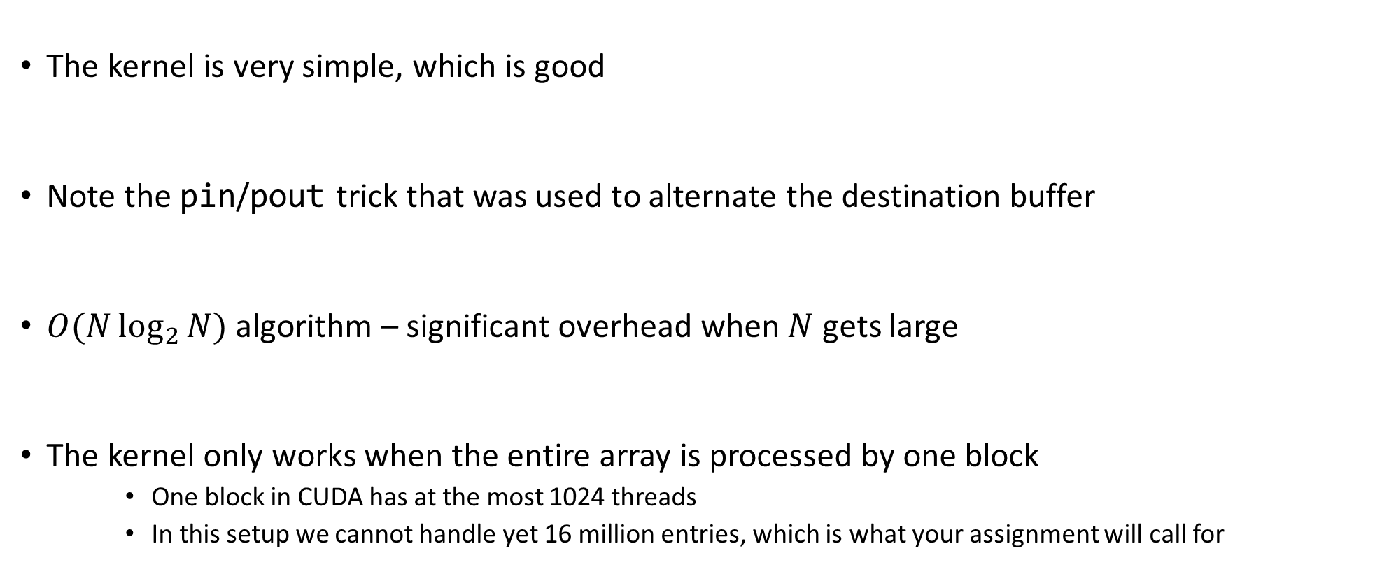
Hillis & Steele: Kernel Function, Quick Remarks
The kernel is very simple, which is good
Note the pin/pout trick that was used to alternate the destination buffer
$O(N\log_{2}{N})$ algorithm – significant overhead when $N$ gets large
The kernel only works when the entire array is processed by one block
One block in CUDA has at the most 1024 threads
In this setup we cannot handle yet 16 million entries, which is what your assignment will call for

Slide 72
Parallel Scan Algorithm: Solution #2: Harris-Sengupta-Owen (2007)
A common parallel algorithm pattern:
Balanced Trees
Build a balanced binary tree on the input data and sweep it to the root and then back into the leaves
Tree is not an actual data structure, but a concept to determine what each thread does at each step
For scan:
Traverse from leaves to root building partial sums at internal nodes in the tree
Root holds sum of all leaves → nice, this is a reduction algorithm
Traverse the tree back building the scan from the partial sums
Called down-sweep phase
72

Slide 73
Picture and Pseudocode: The Reduction Step (“sweep to root”)
j·2^{k+1}-1 =
1 3 5 7
3 7 -1 -1
7 -1 -1 -1
j·2^{k+1}-2^{k}-1 =
0 2 4 6
1 5 -1 -1
3 -1 -1 -1
for k=0 to M-1
offset = 2^{k}
for j=1 to 2^{M-k-1} do in parallel
x[j·2^{k+1}-1] = x[j·2^{k+1}-1] + x[j·2^{k+1}-2^{k}-1]
endfor
endfor
NOTE: “-1” entries
indicate no-ops
NVIDIA [M. Harris]→

Slide 74
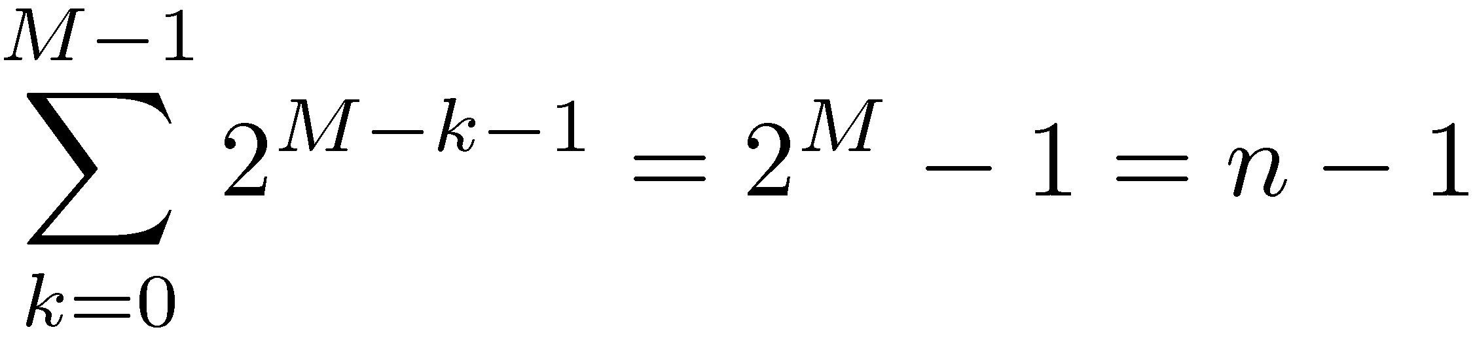
Operation Count, Reduce Phase
for k=0 to M-1
offset = 2^{k}
for j=1 to 2^{M-k-1} do in parallel
x[j·2^{k+1}-1] = x[j·2^{k+1}-1] + x[j·2^{k+1}-2^{k}-1]
endfor
endfor
By inspection:
Looks promising in terms of
operation count…

Slide 75
The “root to leaves” sweep
NOTE: This is just a mirror
image of the reduction
stage. Easy to come up with
the indexing scheme…
for k=M-1 to 0
offset = 2^{k}
for j=1 to 2^{M-k-1} do in parallel
dummy = x[j·2^{k+1}-2^{k}-1]
x[j·2^{k+1}-2^{k}-1] = x[j·2^{k+1}-1]
x[j·2^{k+1}-1] = x[j·2^{k+1}-1] + dummy
endfor
endfor
Set aside
Overwrite op.
Use
NVIDIA [M. Harris]→

Slide 76
Down-Sweep Phase, Remarks
Number of operations for the down-sweep phase:
Additions: n-1
Overwrite ops. : n-1 (each overwrite shadows an addition)
Total number of operations associated with this algorithm
Additions: 2n-2
Overwrite ops: n-1
Looks comparable with the work load in the sequential solution
Convoluted algorithm, indexing tricky to figure out
Kernel shown on next slide

Slide 77
01| __global__ void prescan(float *g_odata, float *g_idata, int n)
02| {
03| extern volatile __shared__ float temp[];// allocated on invocation
04|
05|
06| int thid = threadIdx.x;
07| int offset = 1;
08|
09| temp[2*thid] = g_idata[2*thid]; // load input into shared memory
10| temp[2*thid+1] = g_idata[2*thid+1];
11|
12| for (int d = n>>1; d > 0; d >>= 1) // build sum in place up the tree
13| {
14| __syncthreads();
15|
16| if (thid < d) {
18| int ai = offset*(2*thid+1)-1;
19| int bi = offset*(2*thid+2)-1;
20|
21| temp[bi] += temp[ai];
22| }
23| offset <<= 1; //multiply by 2 implemented as bitwise operation
24| }
25|
26| if (thid == 0) { temp[n - 1] = 0; } // clear the last element
27|
28| for (int d = 1; d < n; d *= 2) // traverse down tree & build scan
29| {
30| offset >>= 1;
31| __syncthreads();
32|
33| if (thid < d)
34| {
35| int ai = offset*(2*thid+1)-1;
36| int bi = offset*(2*thid+2)-1;
37|
38| float t = temp[ai];
39| temp[ai] = temp[bi];
40| temp[bi] += t;
41| }
42| }
43|
44| __syncthreads();
45|
46| g_odata[2*thid] = temp[2*thid]; // write results to device memory
47| g_odata[2*thid+1] = temp[2*thid+1];
48| }
Argument list:
g_odata – pointer to output data, stored in device global memory
g_idata – pointer to input data, stored in device global memory
n – size of array on which prefix scan performed (assumed a power of 2)
NVIDIA [M. Harris]→

Slide 78
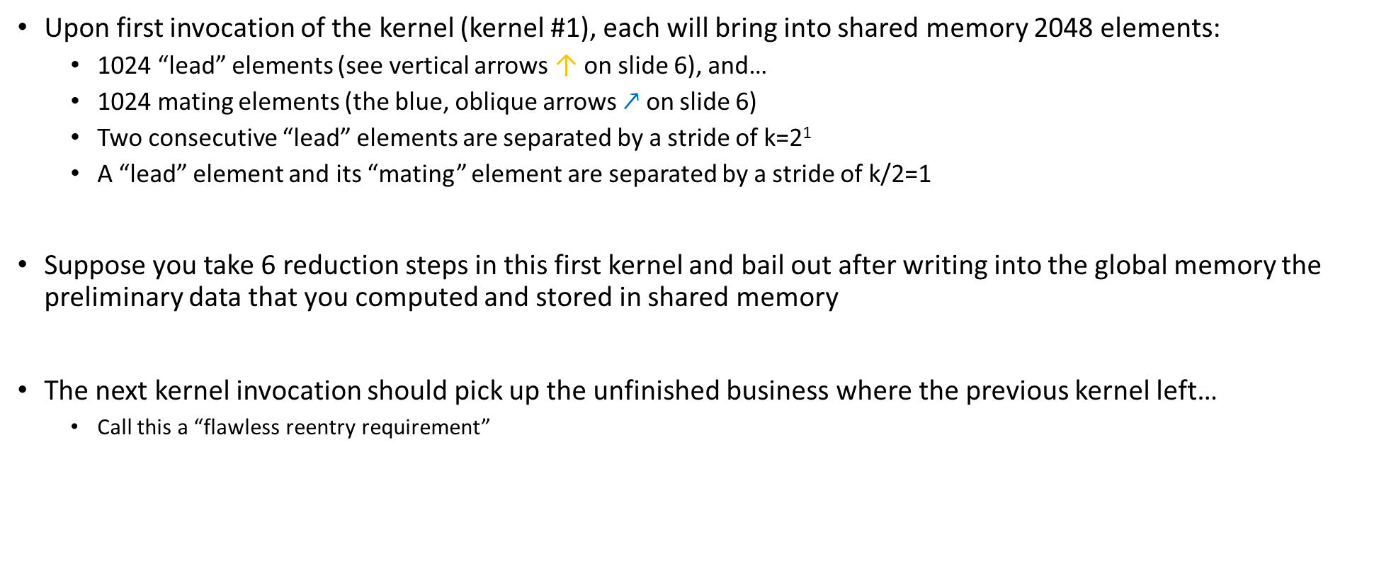
Going Beyond 2048 Entries [1/3]
Upon first invocation of the kernel (kernel #1), each will bring into shared memory 2048 elements:
1024 “lead” elements (see vertical arrows ↑ on slide 6), and…
1024 mating elements (the blue, oblique arrows $↗$ on slide 6)
Two consecutive “lead” elements are separated by a stride of k=2¹
A “lead” element and its “mating” element are separated by a stride of k/2=1
Suppose you take 6 reduction steps in this first kernel and bail out after writing into the global memory the preliminary data that you computed and stored in shared memory
The next kernel invocation should pick up the unfinished business where the previous kernel left…
Call this a “flawless reentry requirement”

Slide 79
Going Beyond 2048 Entries [2/3]
Upon the second kernel call, each block will bring into shared memory 2048 elements:
1024 “lead” elements, and…
1024 “mating” elements
Two consecutive “lead” elements that you bring in will be separated in global memory by a stride of k=2⁶
A “lead” element and its “mating” element are separated by a stride of k/2=2⁵
Thus, when brining in data from global memory, you are not going to bring over a contiguous chunk of memory of size 2048, rather you’ll have to jump 2⁵ locations between successive “lead and mating element” pairs
However, once you bring data in shared memory, you process as before
Before you exit kernel #2 you have to write back data from shared memory into global memory
Again, you have to choreograph this shared to global memory store since there is a 2⁵ stride that comes into play
If you exit kernel #2 after say 4 more reduction steps, the next time you re-enter the kernel (#3) you will have k=2¹⁰

Slide 80
Going Beyond 2048 Entries [3/3]
You will continue the reduction stage until the stride is 2^{M-1}
At this point you are ready to start the root-to-leaves sweep phase
“root-to-leaves” sweep phase carried out in a similar fashion: we will have to invoke the kernel several times
Always work in shared memory and copy back data to global memory before bailing out
The challenges here are:
Understanding the indexing into the global memory to bring data into ShMem
How to loop across the data in shared memory
Numerous shared memory bank conflicts since strides are powers of 2
Shared memory bank conflicts: discussed next
Advanced topic: get rid of the bank conflict through padding

Slide 81
Concluding Remarks, Parallel Scan
Intuitively, the scan operation is not the type of procedure ideally suited for parallel computing
Even if it doesn’t fit like a glove, leads to good speedup:
# elements | CPU Scan (ms) | GPU Scan (ms) | Speedup
1024 | 0.002231 | 0.079492 | 0.03
32768 | 0.072663 | 0.106159 | 0.68
65536 | 0.146326 | 0.137006 | 1.07
131072 | 0.726429 | 0.200257 | 3.63
262144 | 1.454742 | 0.326900 | 4.45
524288 | 2.911067 | 0.624104 | 4.66
1048576 | 5.900097 | 1.118091 | 5.28
2097152 | 11.848376 | 2.099666 | 5.64
4194304 | 23.835931 | 4.062923 | 5.87
8388688 | 47.390906 | 7.987311 | 5.93
16777216 | 94.794598 | 15.854781 | 5.98
Source: 2007 paper of Harris, Sengupta, Owens

Slide 82
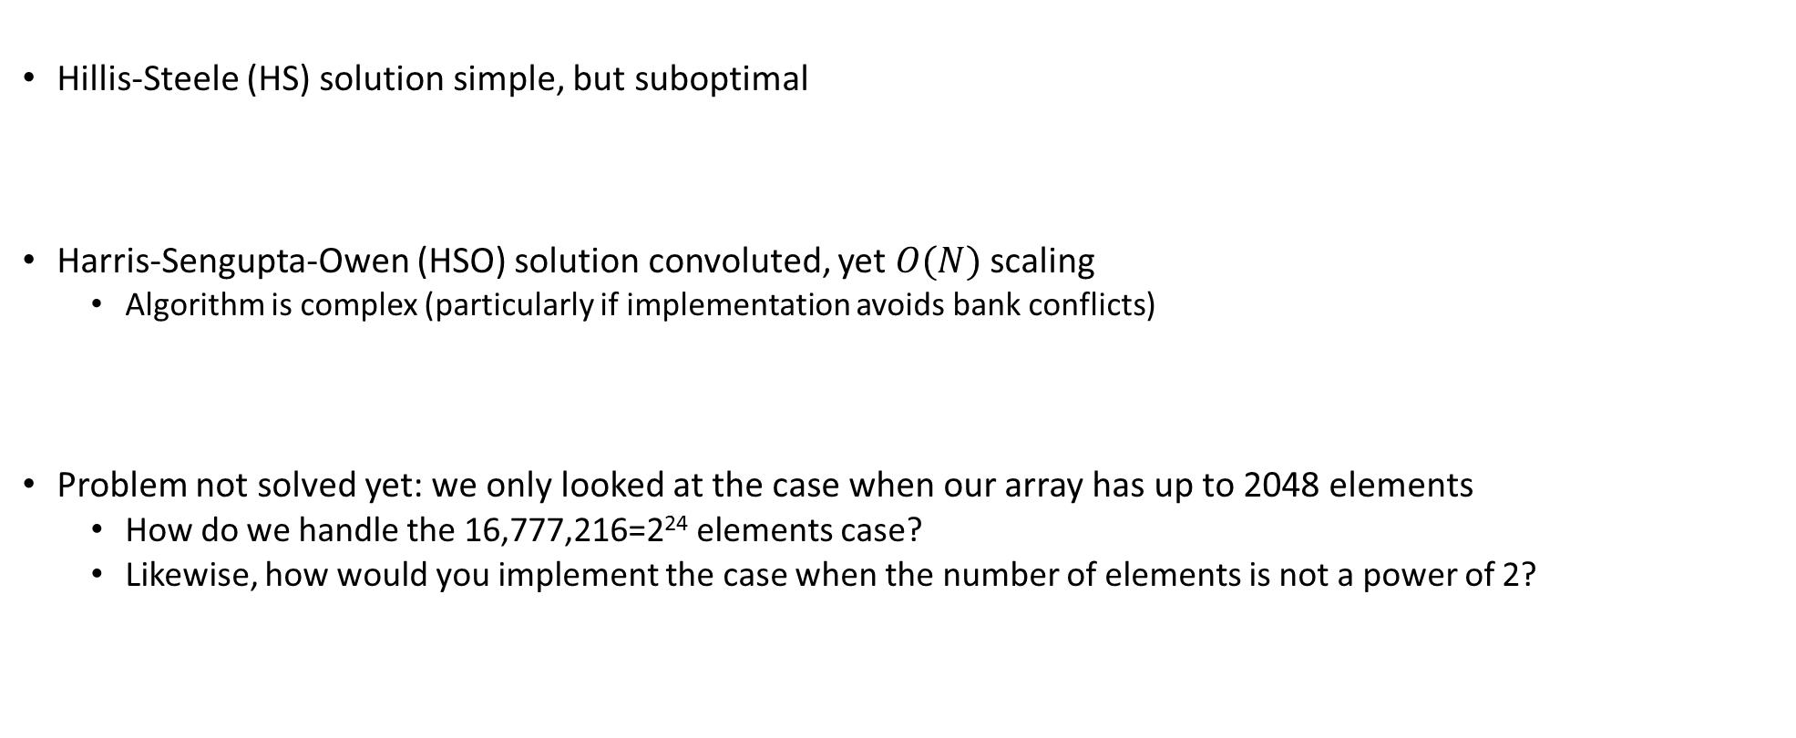
Concluding Remarks, Parallel Scan
Hillis-Steele (HS) solution simple, but suboptimal
Harris-Sengupta-Owen (HSO) solution convoluted, yet $O(N)$ scaling
Algorithm is complex (particularly if implementation avoids bank conflicts)
Problem not solved yet: we only looked at the case when our array has up to 2048 elements
How do we handle the 16,777,216=2²⁴ elements case?
Likewise, how would you implement the case when the number of elements is not a power of 2?

